Slide 1


AWS Code Commit
Wolfgang Unger
AWS Solutions architect | INSTRUCTOR
AWS fully managed source control system

Slide 2


Code Commit
Wolfgang Unger
AWS Solutions Architect | instructor

Slide 3


Chapter overview
Introduction
Code Commit
GIT
CodeCommit
Chapter Overview
Summary
Wolfgang Unger
AWS |Solutions Architect | Instructor

Slide 4
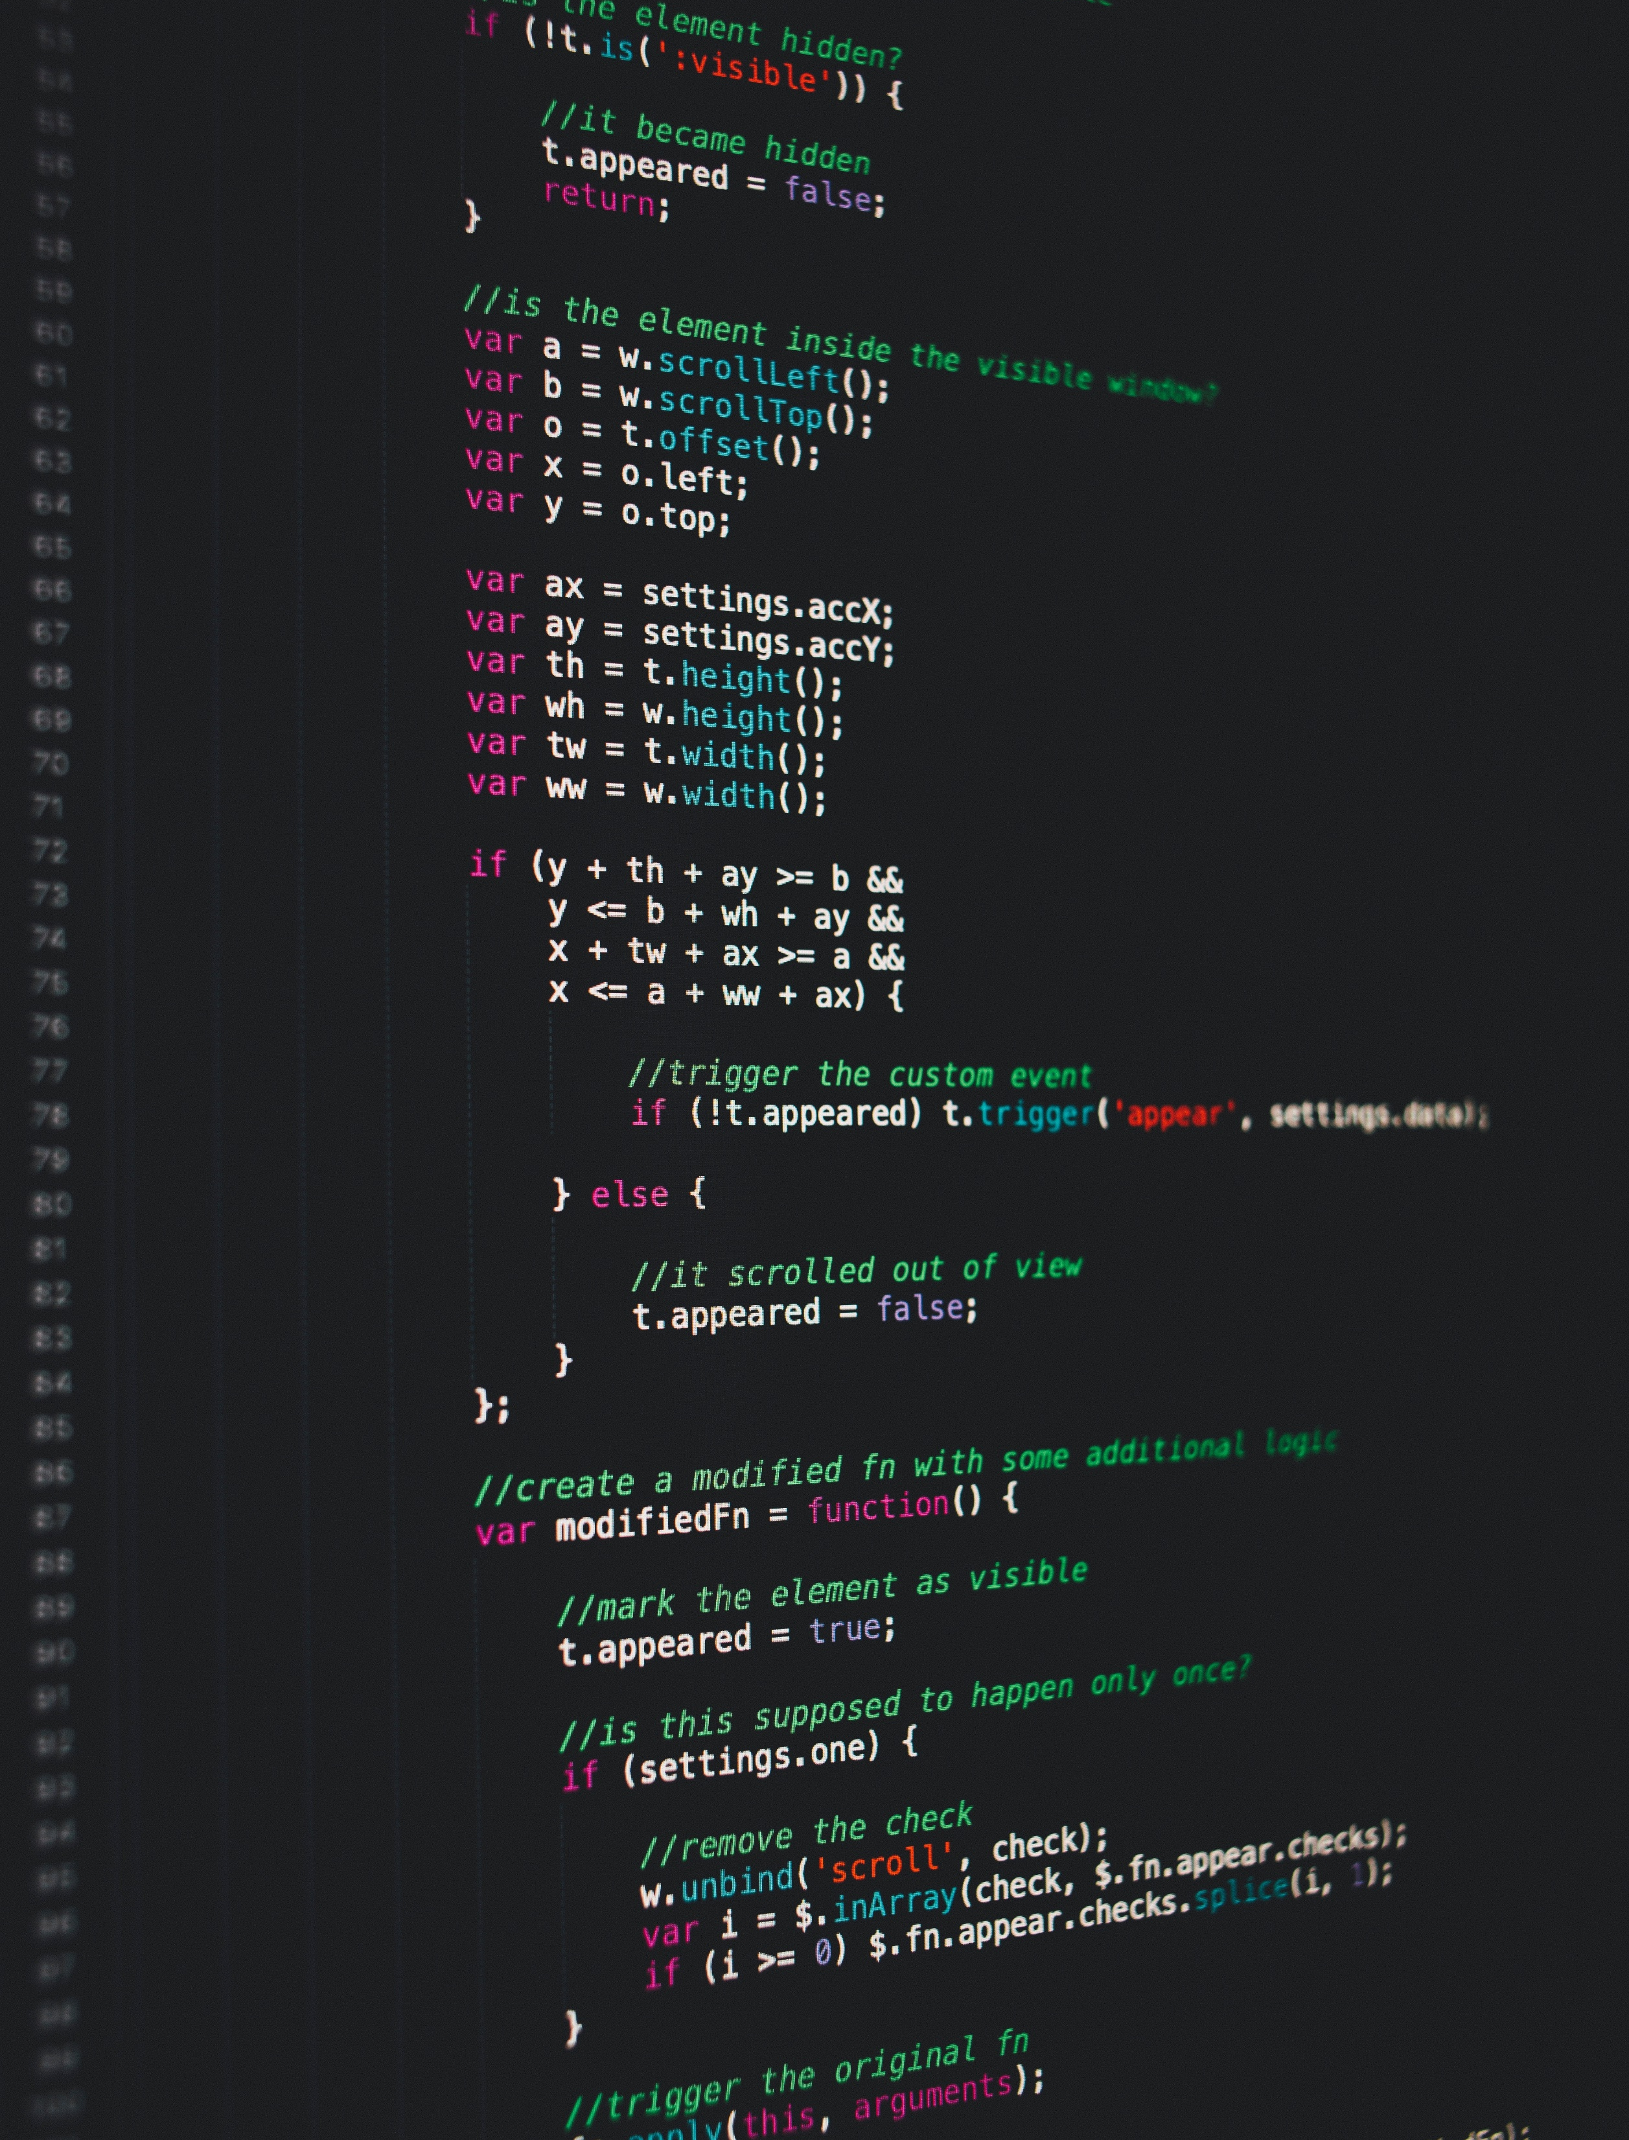
AWS definition :
“AWS CodeCommit is a fully-managed source control service that hosts secure Git-based repositories. It makes it easy for teams to collaborate on code in a secure and highly scalable ecosystem. CodeCommit eliminates the need to operate your own source control system or worry about scaling its infrastructure.”
Notes:
Karel Capek, a Czech novelist introduced and made popular the word robot as a word for artificial human beings. It first appeared in his play R.U.R. (Rossum’s Universal Robots) in 1920. In Czech, the word means worker or servant.

Slide 5
AWS CodeCommit is a version control service hosted by Amazon Web Services that you can use to privately store and
manage files, such as documents, source code, and binary files in the cloud.
It supports the standard functionality of Git, so it works seamlessly with your existing Git-based tools.
Or with other words:
With CodeCommit you can host private Git repositories on AWS.
Notes:
The official definition of a robot, by Robot Institute of America.

Slide 6


TITLE TEXT
GIT
Cloud Guru GIT course 1
Cloud Guru GIT course 2
This course is perfect to learn GIT from the basics to advanced features …add Link
This course is perfect to learn GIT from the basics to advanced features …add Link
Additional GIT training sources
Pro Git, an online version of the Pro Git book. Written by Scott Chacon. Published by Apress.
Git Immersion, a try-it-yourself guided tour that walks you through the fundamentals of using Git.
Published by Neo Innovation, Inc.
Git Reference, an online quick reference that can also be used as a more in-depth Git tutorial.
Published by the GitHub team.
Git Cheat Sheet with basic Git command syntax. Published by the GitHub team.
Git Pocket Guide. Written by Richard E. Silverman. Published by O'Reilly Media, Inc.

Slide 7

CodeCommit
Feature 1
Master
Feature 2
store and manage assets (such as documents, source code, and binary files) in a private GIT based repository

Slide 8
Benefits
1
GIT based
It supports the standard functionality of Git, so it works seamlessly with your existing Git-based tools.
2
AWS Integration
Good Integration with other AWS services, like CodeBuild, CodePipeline, CloudWatch and more
3
Easy migration to Code Commit
Easily migrate files from other remote repositories.
You can migrate to CodeCommit from any Git-based repository.

Slide 9

Authentication methods
1
HTTPS
Login with a static user name and password. You can configure both in IAM
2
SSH
Login with public and private key pairs. You can upload your public key in the IAM console

Slide 10
Title Text
CodeCommit Objects & Glossar
Repository
Source file
Commit
Branch
A repository is the main version control object in CodeCommit, it's where you securely store code and files for your project
A file is a version-controlled, self-contained piece of information available to you and other users of the repository.
Commits are snapshots of the contents and changes to the contents of your repository. Every time a user commits and pushes a change, that information is saved and stored.
You can use branches to separate work on a new or different version of files without impacting work in other branches. You can use branches to develop new features and more.
Pull Request
Tag
Trigger
Credentials
A pull request is the primary way you and other repository users can review, comment on, and merge code changes from one branch to another.
You can use a tag to mark a commit with a label that helps other repository users understand its importance.
You can setup event triggers to push actions like SNS or Lambda functions
Your user credentials to authenticate against CodeCommit. Can be HTTPS or SSH

Slide 11
Chapter overview
Introduction and chapter overview
Create first CodeCommit Repo
Browse files in Repo
Integration with Eclipse and VisualStudio
Triggers and webhooks
Branches
Pull requests
Summary
Notes:
Karel Capek, a Czech novelist introduced and made popular the word robot as a word for artificial human beings. It first appeared in his play R.U.R. (Rossum’s Universal Robots) in 1920. In Czech, the word means worker or servant.

